Slide 1
Stuctured Programming Methodology
Module 4:
Functions

Slide 2
Functions
User Defined Functions: Need, Function Declaration and Definition, Return Values, Function Calls, Passing Arguments to a Function by Value, Recursive functions, String Handling functions (in-built)

Slide 3
Functions
A function is a block of statements that performs a specific task. Let’s say you are writing a C program and you need to perform a same task in that program more than once.
In such case you have two options:
a) Use the same set of statements every time you want to perform the task
b) Create a function to perform that task, and just call it every time you need to perform that task.
Using option (b) is a good practice and a good programmer always uses functions while writing code in C/C++.
C++ also supports advanced features like function overloading, default arguments, and inline functions, which give more flexibility compared to C.

Slide 4
Functions
Why we need functions in C++
Functions are used because of following reasons –
To improve the readability of code.
Improves the reusability of the code, same function can be used in any program rather than writing the same code from scratch.
Debugging of the code would be easier if you use functions, as errors are easy to be traced.
Reduces the size of the code, duplicate set of statements are replaced by function calls.

Slide 5
Functions
Types of functions
1) Predefined standard library functions
Standard library functions are also known as built-in functions.
Functions such as cout, sqrt(), abs(), and getline() etc are standard library functions.
These functions are already defined in header files (files with .h extensions are called header files such as <iostream>, <cmath>, or <string>.), so we just call them whenever there is a need to use them.
Note:
main() is a special user-defined function that must be present in every C++ program.
It is the entry point of the program where execution begins. The compiler doesn’t provide it for you, you write it yourself.

Slide 6
Functions
Types of functions
2) User Defined functions
The functions that we create in a program are known as user defined functions or in other words you can say that a function created by user is known as user defined function.
Now we will learn how to create user defined functions and how to use them in C++

Slide 7
Functions
User Defined functions : Syntax of a function
return_type function_name (argument list)
{
Set of statements – Block of code
}
return_type: Return type can be of any data type such as int, double, char, void, short etc.
function_name: It can be anything, however it is advised to have a meaningful name for the functions so that it would be easy to understand the purpose of function just by seeing it’s name.
argument list: Argument list contains variables names along with their data types. These arguments are kind of inputs for the function. For example – A function which is used to add two integer variables, will be having two integer argument.
Block of code: Set of C statements, which will be executed whenever a call will be made to the function.

Slide 8
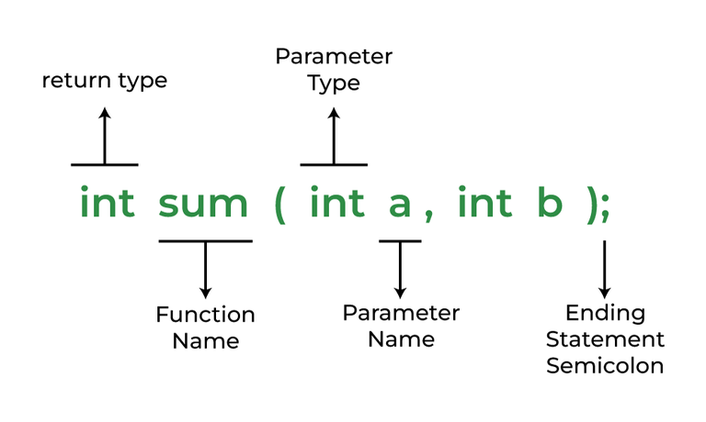
Example

Slide 9
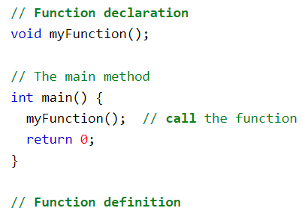

Function Declaration and Definition
A function consist of 3 parts:
Declaration:
the function's name, return type, and parameters (if any)
Definition:
the body of the function (code to be executed)
Function Calls:
A function call is a statement that instructs the compiler to execute the function.

Slide 10
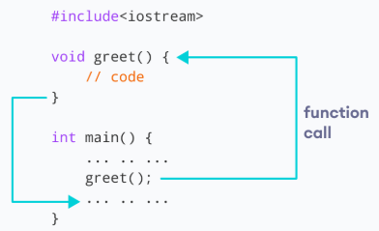
How function works in c++

Slide 11
Functions
Lets take an example – Suppose you want to create a function to add two integer variables.
For example lets take the name addition for this function.
return_type addition(argument list)
This function addition adds two integer variables, which means we need two integer variable as input, lets provide two integer parameters in the function signature. The function signature would be –
return_type addition(int num1, int num2)
The result of the sum of two integers would be integer only. Hence function should return an integer value – we got our return type – It would be integer –
int addition(int num1, int num2);
So we got our function prototype or signature. Now we can implement the logic in C program like this:

Slide 12
Example
double AreaR(double,double);// function declaration
double AreaR(double x,double y);//function definition
AreaR(a,b);//function calling

Slide 13
#include <iostream>
using namespace std;
double AreaR(double length, double width) {
return length * width;
}
int main() {
double rectLength, rectWidth;
cout << "Enter the length of the rectangle: "; // Prompt the user for input
cin >> rectLength;
cout << "Enter the width of the rectangle: ";
cin >> rectWidth;
double area = AreaR(rectLength, rectWidth); // Call the function to calculate the area
cout << "The area of the rectangle is: " << area << endl; // Display the result
return 0;
}

Slide 14
Functions
Creating a void user defined function that doesn’t return anything
#include <iostream>
using namespace std;
// Function with return type void and no parameters
void introduction() {
cout << "Hi" << endl;
cout << "My name is Programming" << endl;
cout << "How are you?" << endl;
// No return statement since return type is void
}
int main() {
// Calling function
introduction();
return 0;
}

Slide 15
Functions
Few Points to Note regarding functions in C:
main() in C program is also a function.
2) Each C program must have at least one function, which is main().
3) There is no limit on number of functions; A C program can have any number of functions.
4) A function can call itself and it is known as “Recursion“.

Slide 16
Functions
C Functions Terminologies that must remembered
return type: Data type of returned value. It can be void also, in such case function doesn’t return any value.
Note: for example, if function return type is char, then function should return a value of char type and while calling this function the main() function should have a variable of char data type to store the returned value.

Slide 17
Functions
Task
Write function for
  addition of two integers,
  multiplication of two float numbers and
  display of character

Slide 18
Functions
Function Calls, Passing Arguments to a Function by Value
1) Function – Call by value method – In the call by value method the actual arguments are copied to the formal arguments, hence any operation performed by function on arguments doesn’t affect actual parameters.
2) Function – Call by reference method – Unlike call by value, in this method, address of actual arguments (or parameters) is passed to the formal parameters, which means any operation performed on formal parameters affects the value of actual parameters.

Slide 19
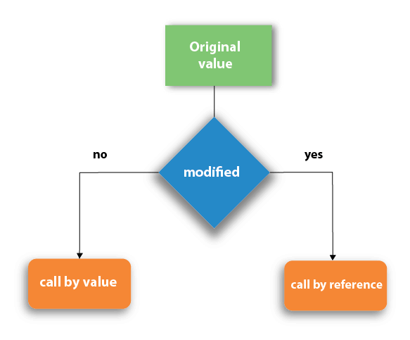

Slide 20
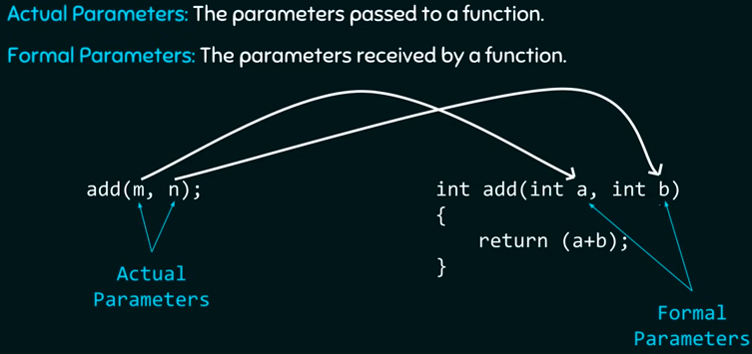
Functions
Function – Call by value method
Actual parameters: The parameters that appear in function calls.
(eg.var1, var2) (Arguments)
Formal parameters: The parameters that appear in function declarations.
(num1, num2) (parameters)

Slide 21

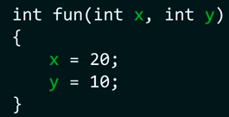
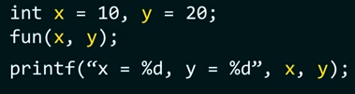



Functions
What is Function Call By value?
When we pass the actual parameters while calling a function then this is known as function call by value.
In this case the values of actual parameters are copied to the formal parameters.
Thus operations performed on the formal parameters don’t reflect in the actual parameters.
Example:
Function definition
Function calling

Slide 22
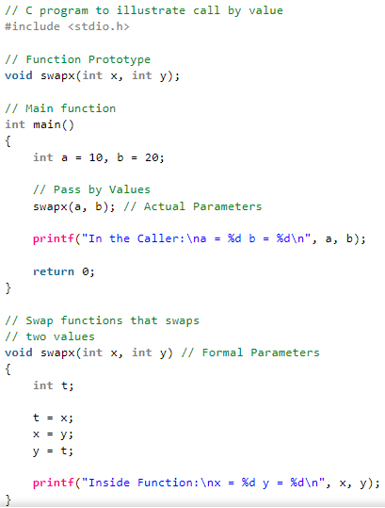
Example:

Slide 23
Functions
Function – Call by value method
#include <iostream>
using namespace std;
int increment(int var) {
var = var + 1;
return var;
}
int main() {
int num1 = 20;
int num2 = increment(num1);
cout << "num1 value is: " << num1 << endl;
cout << "num2 value is: " << num2 << endl;
return 0;
}
Output: ?

Slide 24
Functions
Function – Call by value method
#include <iostream>
using namespace std;
int increment(int var) {
var = var + 1;
return var;
}
int main() {
int num1 = 20;
int num2 = increment(num1);
cout << "num1 value is: " << num1 << endl;
cout << "num2 value is: " << num2 << endl;
return 0;
}
Output:
num1 value is: 20
num2 value is: 21

Slide 25
Functions
Swapping numbers using Function Call by Value
#include <iostream>
using namespace std;
void swapnum(int var1, int var2) {
int tempnum;
tempnum = var1;
var1 = var2;
var2 = tempnum;
// Changes happen only inside this function (local copy),
// not reflected in main() because it's call by value.
}
int main() {
int num1 = 35, num2 = 45;
cout << "Before swapping: " << num1 << ", " << num2 << endl;
// calling swap function
swapnum(num1, num2);
cout << "After swapping: " << num1 << ", " << num2 << endl;
return 0;
}
Output:?

Slide 26
Functions
Swapping numbers using Function Call by Value
#include <iostream>
using namespace std;
void swapnum(int var1, int var2) {
int tempnum;
tempnum = var1;
var1 = var2;
var2 = tempnum;
// Changes happen only inside this function (local copy),
// not reflected in main() because it's call by value.
}
int main() {
int num1 = 35, num2 = 45;
cout << "Before swapping: " << num1 << ", " << num2 << endl;
// calling swap function
swapnum(num1, num2);
cout << "After swapping: " << num1 << ", " << num2 << endl;
return 0;
}
Output:
Before swapping: 35, 45
After swapping: 35, 45
The reason is – function is called by value for num1 & num2. So actually var1 and var2 gets swapped (not num1 & num2). As in call by value actual parameters are just copied into the formal parameters.

Slide 27
Functions
Function – Call by reference method
Actual parameters: The parameters that appear in function calls.
(eg.var1, var2)
Formal parameters: The parameters that appear in function declarations.
(num1, num2)
What is Function Call By reference?
Unlike call by value, in this method, address of actual arguments (or parameters) is passed to the formal parameters, which means any operation performed on formal parameters affects the value of actual parameters.

Slide 28
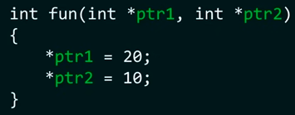

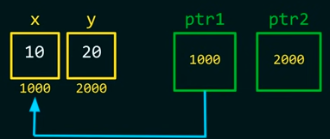
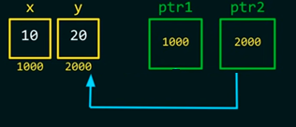
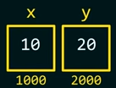
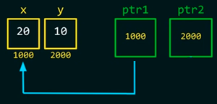
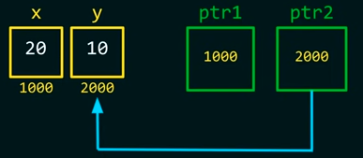

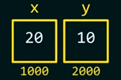
Example:

Slide 29
Functions
Swapping numbers using Function Call by reference
#include <iostream>
using namespace std;
// Call by reference using reference variables
void swapnum(int &var1, int &var2) {
int tempnum;
tempnum = var1;
var1 = var2;
var2 = tempnum;
}
int main() {
int num1 = 35, num2 = 45;
cout << "Before swapping:";
cout << "\nnum1 value is " << num1;
cout << "\nnum2 value is " << num2 << endl;
swapnum(num1, num2); // calling swap function
cout << "\nAfter swapping:";
cout << "\nnum1 value is " << num1;
cout << "\nnum2 value is " << num2 << endl;
return 0;
}
Output:?

Slide 30
Functions
Swapping numbers using Function Call by reference
#include <iostream>
using namespace std;
// Call by reference using reference variables
void swapnum(int &var1, int &var2) {
int tempnum;
tempnum = var1;
var1 = var2;
var2 = tempnum;
}
int main() {
int num1 = 35, num2 = 45;
cout << "Before swapping:";
cout << "\nnum1 value is " << num1;
cout << "\nnum2 value is " << num2 << endl;
swapnum(num1, num2); // calling swap function
cout << "\nAfter swapping:";
cout << "\nnum1 value is " << num1;
cout << "\nnum2 value is " << num2 << endl;
return 0;
}
Output:
Before swapping:
num1 value is 35
num2 value is 45
After swapping:
num1 value is 45
num2 value is 35
The values of the variables have been changed after calling the swapnum() function because the swap happened on the addresses of the variables num1 and num2.

Slide 31
Exercise
Write a program to check whether given number is pallindrome or not. (Read number as user input).
Expected op:
  Enter the number: 123
  Given number is not palindrome
  Enter the number: 121
  Given number is palindrome

Slide 32
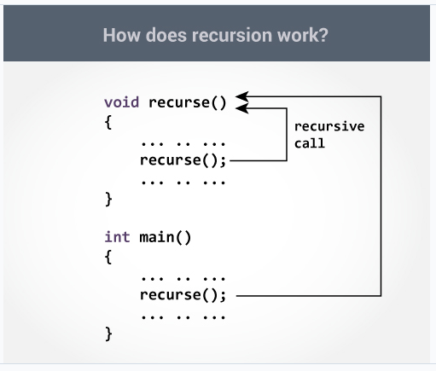
Functions
Function – Recursion.
A function that calls itself is known as a recursive function. And, this technique is known as recursion.

Slide 33
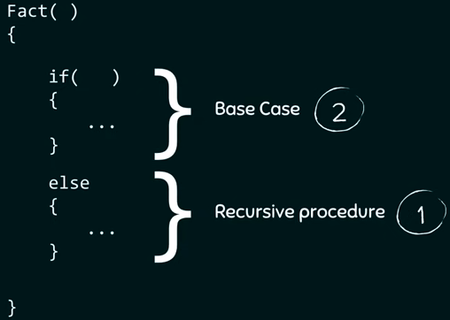
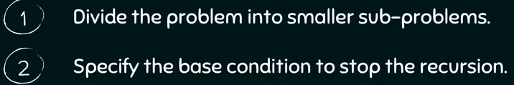
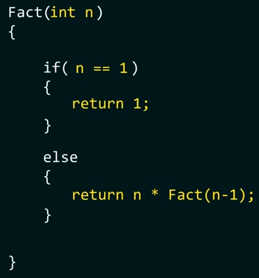
Step 1: divide the problem
  Fact(1)=1
  Fact(2)=2*1
  Fact(2)= 2* fact(1)
  Fact(3)=3*2*1
  Fact(3)= 3* fact(2)
  Fact(2)=4*3*2*1
  Fact(4)= 4* fact(3)
  ...
  Fact(n)= n* fact(n-1)
Step2: base condition
Fact(1)=1

Slide 34
Functions
Function – Recursion---Example: Sum of Natural Numbers Using Recursion
#include <iostream>
using namespace std;
// Function Declaration
int sum(int n) {
if (n != 0)
return n + sum(n - 1); // Recursive call
else
return 0;
}
int main() {
int number, result;
cout << "Enter a positive integer: ";
cin >> number;
result = sum(number);
cout << "Sum = " << result << endl;
return 0;
}
int sum(int n) {
if (n != 0)
return n + sum(n - 1); // Recursive call
else
return 0;
}

Slide 35
Functions
Task
Find factorial of a number using recursion

Slide 36
Calclulate GCD of two numbers
GCD of two numbers using function
int gcd_num(int x, int y) { // Function to calculate GCD
int rem;
while (y != 0) {
rem = x % y;
x = y;
y = rem;
} return x;
}
int main() {
int a, b, res;
cout << "Enter two numbers: ";
cin >> a >> b;
res = gcd_num(a, b);
cout << "GCD of " << a << " and " << b << " is " << res << endl;
return 0; }
GCD of two numbers
#include <iostream>
using namespace std;
int main() {
int a, b, r = 0;
cout << "Enter two numbers: ";
cin >> a >> b;
while (b != 0) {
r = a % b;
a = b;
b = r;
}
cout << "GCD is: " << a << endl;
return 0;

Slide 37

LCD of two numbers
The formula to find the LCM of two numbers:

Slide 38
C++ Program to print the string using a function
#include <iostream>
using namespace std;
void printString(char* str) { // Function to print the string
cout << "Array of Characters: ";
int i = 0;
while (str[i] != '\0') {
cout << str[i] << " ";
i++;
}
cout << endl;
}
int main() {
char arr[] = "String";
printString(arr);
return 0;
}

